Slide 1


SALES ANALYSIS

Slide 2

Contexte
Reason for the project
We need to to examine our different indicators and key figures
This will allow us to decide on planning for the future

Slide 3

Part 1 – Sales Indicators

Slide 4

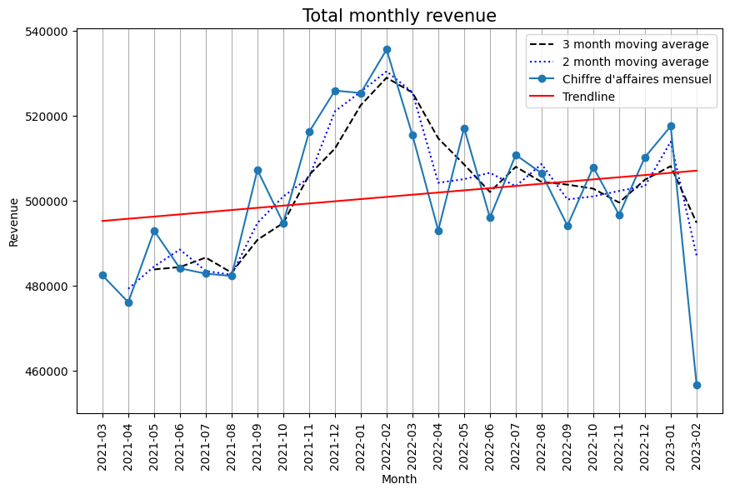
Revenue
€12,027,663.10
Total revenue

Slide 5
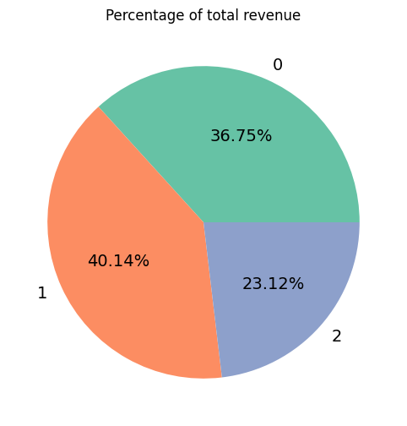
Revenue by category
2292
1928
Number of Category 0 products
Average revenue per product - category 0
737
6550
Number of Category 1 products
Average revenue per product - category 1
236
11780
Number of Category 2 products
Average revenue per product - category 2

Slide 6

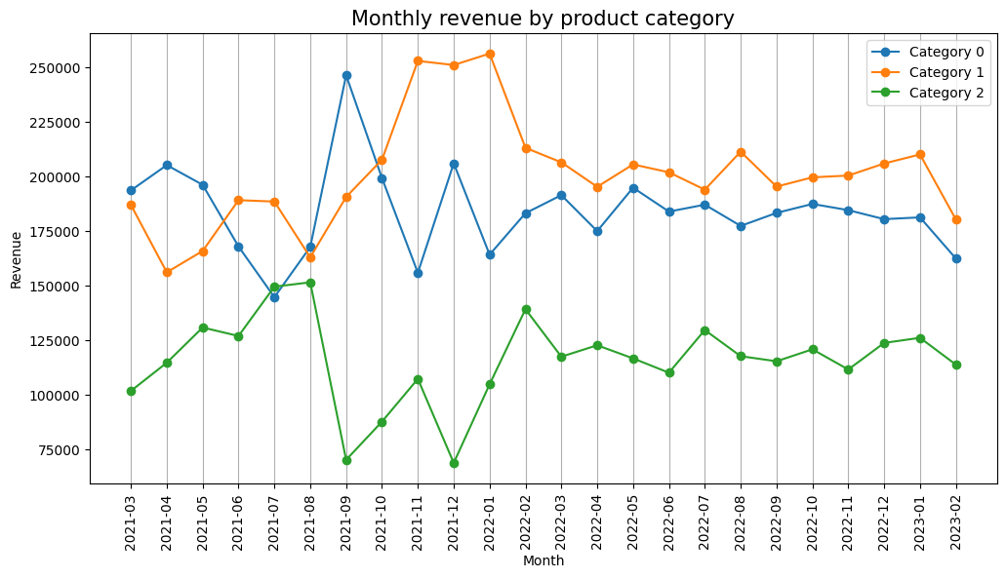
Monthly revenue by category

Slide 7
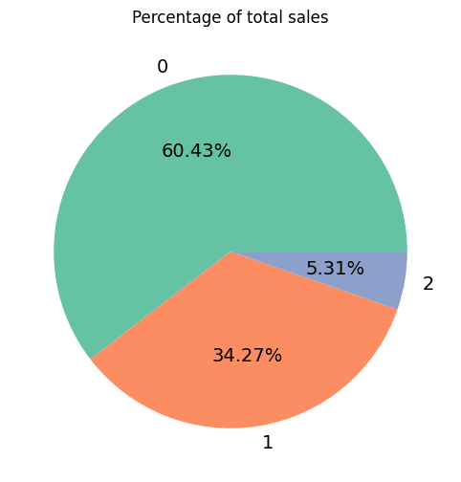
Product Sales
2292
181
Number of Category 0 products
Category 0 - Average sales per product
737
319
Number of Category 1 products
Category 1 - Average sales per product
236
154
Number of Category 2 products
Category 2 - Average sales per product

Slide 8
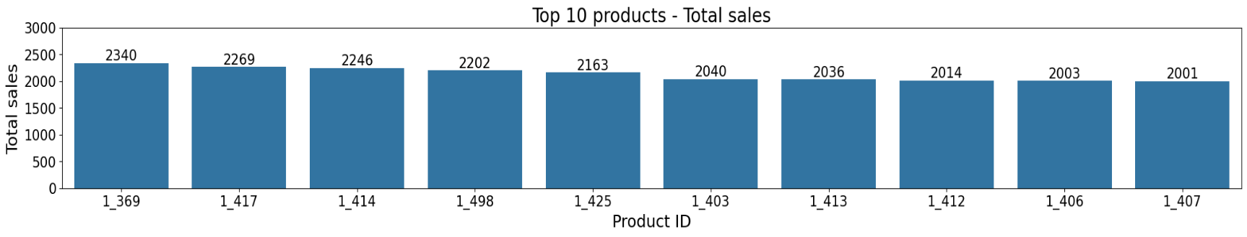
Top 10 Products – Total Sales

Slide 9
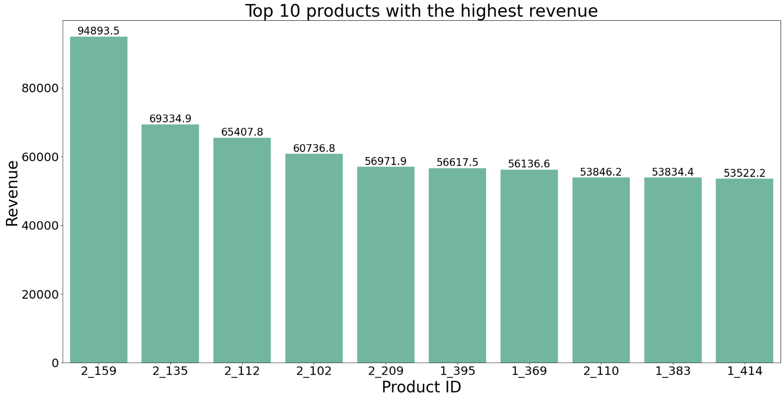
Top 10 Products – Highest Revenue

Slide 10

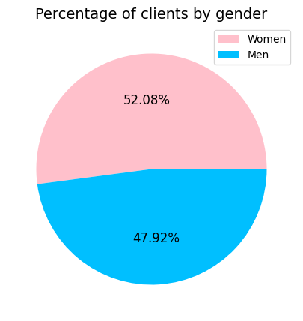
Client Gender Distribution

Slide 11

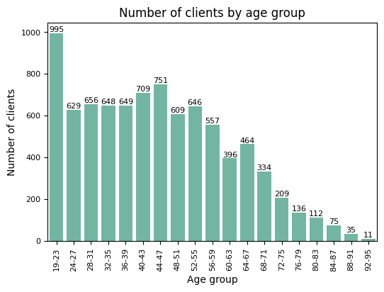
Client Ages

Slide 12

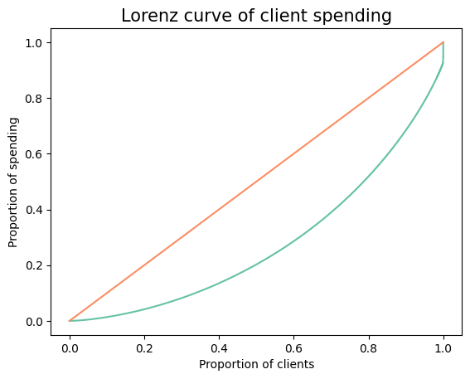
Lorenz Curve
0.44
Gini Index

Slide 13

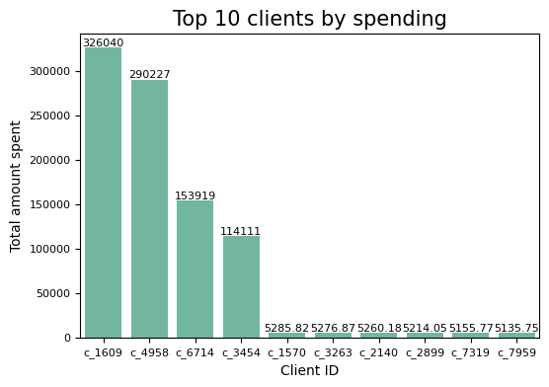
Top 10 Clients - Spending

Slide 14

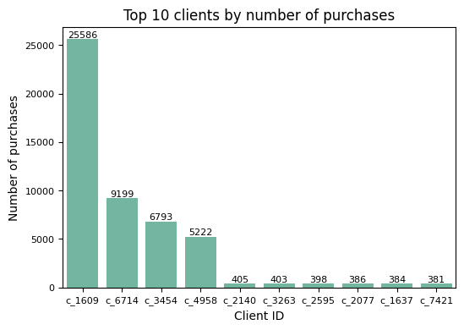
Top 10 Clients – Number of Purchases

Slide 15

Part 2 – Our clients

Slide 16
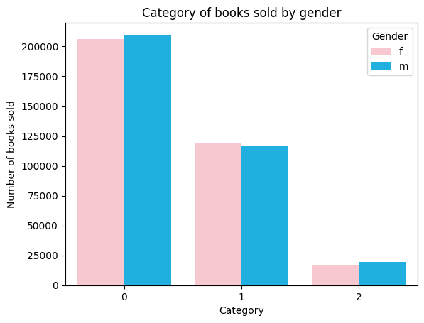
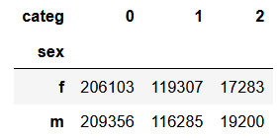
Client gender and categories of books purchased
158.25
Chi2 Statistic
4.32e-35
P-value
- Null hypothesis (H0): No association between gender and category of books purchased.
- Alternative hypothesis (H1): There is an association between the gender and the category of books purchased.
The high chi2 statistic and very low p-value suggest that there is a link between gender and the category of books purchased.

Slide 17
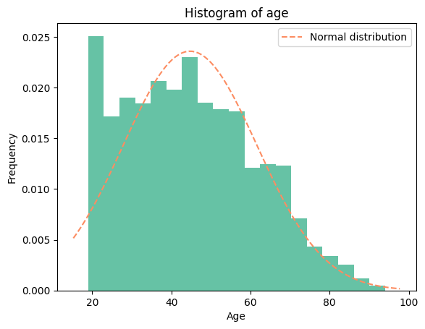
Customer age and total spending
Kolmogorov-Smirnov test for normality - Age
0.0656
Statistic
0.0008518
P-value
H0: The dataset follows a normal distribution
H1: The dataset does not follow a normal distribution
Relatively small statistic = a small difference between the normal distribution and our data.
A low p-value = Alternative hypothesis

Slide 18
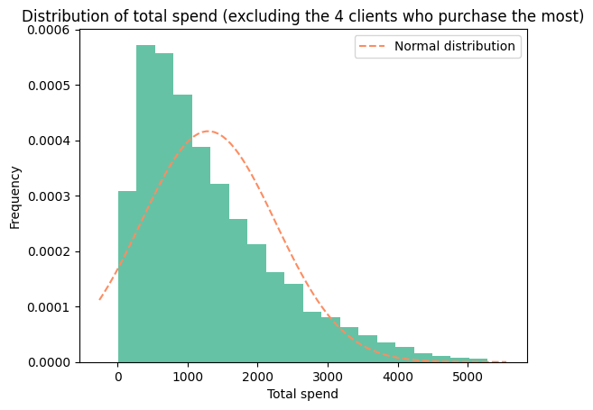
Customer age and total spending
Kolmogorov-Smirnov test for normality – total spend
0.4106
Statistic
1.3377e-136
P-value
H0: The dataset follows a normal distribution
H1: The dataset does not follow a normal distribution
A large statistic = the data is very different from a normal distribution.
A low p-value = Alternative hypothesis

Slide 19
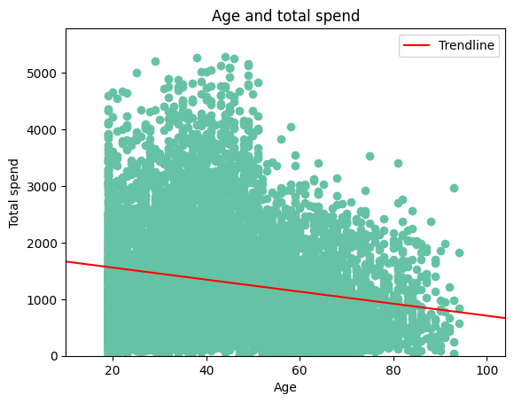
Customer age and total spending
Spearman correlation
-0.1844
Spearman correlation
1.2374e-66
P-value
H0: No association between customer age and total purchase amount
H1: There is an association between customer age and total purchase amount
Spearman correlation and a low p-value = a weak negative relationship between age and total amount

Slide 20
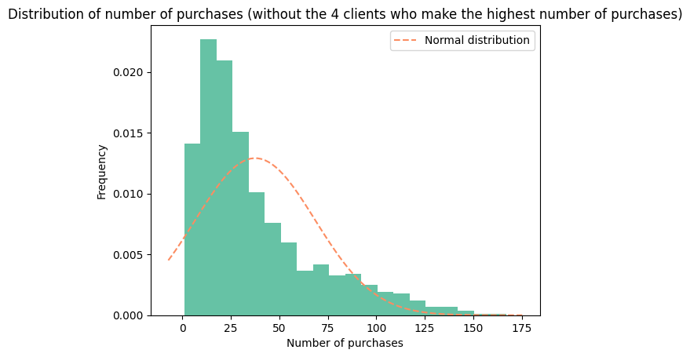
Customer age and number of purchases
Test de Kolmogorov-Smirnov – Number of purchases
0.413
Statistic
3.184e-138
P-value
H0: The dataset follows a normal distribution
H1: The dataset does not follow a normal distribution
A large statistic = the data is very different from a normal distribution
A very low p-value = Alternative hypothesis

Slide 21
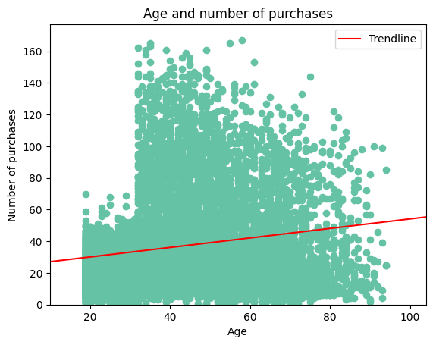
Customer age and number of purchases
Spearman correlation
0.2118
Spearman correlation
8.80e-88
P-value
H0: No association between customer age and purchase frequency
H1: There is an association between customer age and purchasing frequency
Spearman correlation and a low p-value = a weak and positive link between age and purchasing frequency

Slide 22
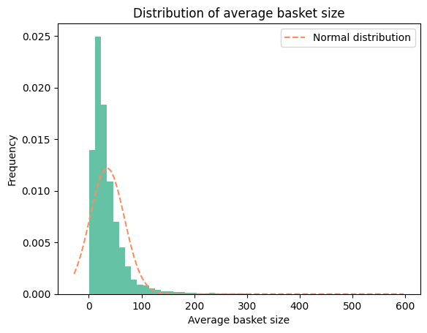
Customer age and average basket size
Kolmogorov-Smirnov test – Average basket size
0.1643
Statistic
5.4041e-24
P-value
A small statistic = not too far from a normal distribution
,A very low p-value = Alternative hypothesis
H0: The dataset follows a normal distribution
H1: The dataset does not follow a normal distribution

Slide 23
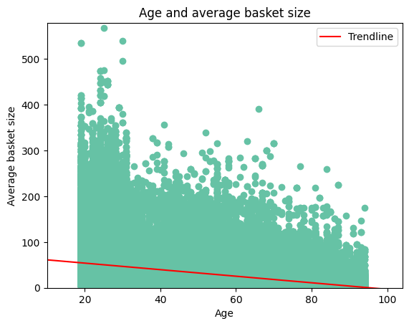
Customer age and average basket size
Spearman correlation
-0.34
Spearman correlation
0.0
P-value
H0: No association between customer age and average basket size
H1: There is an association between customer age and average basket size
Spearman correlation and a low p-value = a moderate, negative relationship between age and average basket size.

Slide 24
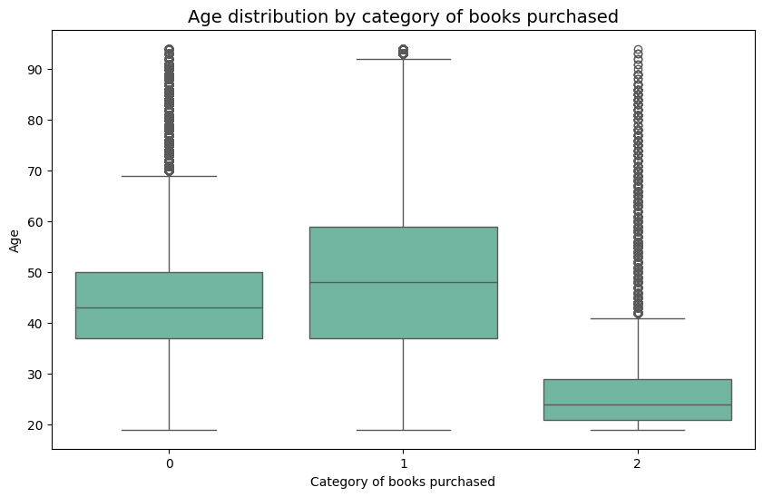
Customer age and categories of books purchased
Levene test – Equality of variances
26975.65
Statistic
0.0
P-value
The large value of the statistic and the small p-value = variances are unequal variances.
H0: The variance between groups is equal
H1: The variance between groups is not equal

Slide 25
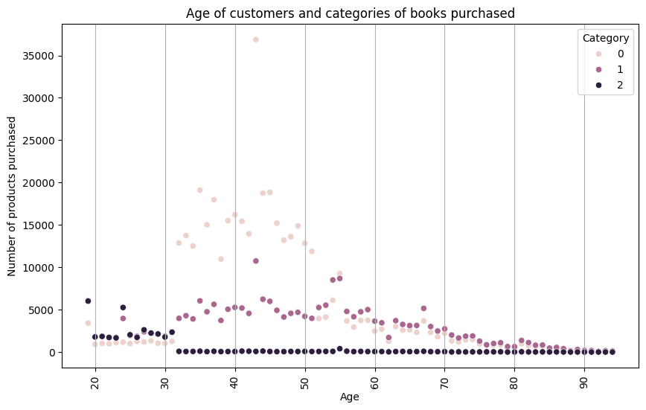
Customer age and categories of books purchased
Kruskal-Wallis test
78458.43
Statistique
0.0
P-value
A very high statistic = the age distributions for each category are very different.
A very low p-value = the two variables are linked.
H0: No association between customer age and categories of books purchased
H1: There is an association between the age of customers and the categories of books purchased

Slide 26




Conclusion
Monthly revenue may be seasonal
Over the past two years, sales have fallen after the Christmas and New Year period, and sales of Category 2 books have increased each year in July. It could be useful to have promotions in low season to increase turnover in months where turnover is lower.
Category 2 – Low Sales, High Revenue
60% of our sales are category 0, but category 0 only contributes to 36% of our total revenue. On the other hand, only 5.3% of our sales are products from category 2, but category 2 contributes to 23% of our total revenue.
Young people – an interesting demographic
Young people currently make fewer purchases than other demographic groups, but their average basket size is relatively large. They also buy more Category 2 books – the most expensive category. It might be helpful to target this demographic to increase sales and increase revenue.

